Slide 2
Jesus in the Book of Job
The Answers of Jesus to Job
(From Personal Notes taken from Phil Roberts Lecture during his Tenure at Florida College , 1980 )

Slide 3
Author: Divinely Inspired, Human Author Unknown (attributed to Moses, Elihu, Salomón, Ezequiel, Jeremiah, Baruch, Ezdra, Isaiah, etc.
Place: Uz (1:1) Perhaps NE of Palestine - - map
Time: During the age of the Patriarchs, 2000 – 1500 BC
Style: Poetic, “a Masterpiece of Literature” far surpasses the best work ever written
Message: Many Biblical Truths: God is Supreme, Omniscient, Omnipotent, Creator, Has Right and Power to Rule, In Contras to God’s Wisdom and Holiness, Man Falls Short, Very Short … and therefore, Depends on God for Everything
Background
Notes:
Era próspero semejante a Abraham, su riqueza se medía por las posesiones y ganado no por plata ni oro, 1:3
Su vida larga corresponde a aquella de los patriarcas despues del diluvio. Vivio 140 años adicionales a los de su vida de sufrimiento, 42:16,17
No hay mencion de Moisés ni de la ley ni de eventos o instituciones del pacto que Dios hizo con Israel.
Muy probable que Job haya sido gentil.

Slide 4
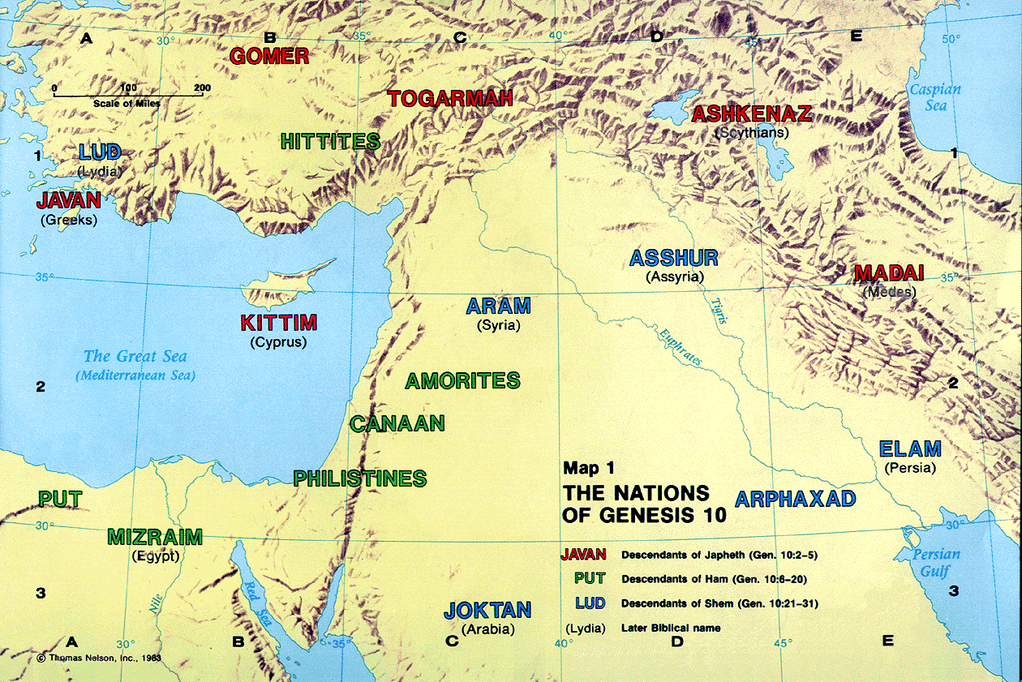
Uz

Slide 5
Introduction:
The Book of Job, a most fascinating, profound piece of literature ever written, “a masterpiece”
In verse 1, we are told 4 qualities about Job:
-- Blameless
-- Upright
-- Feared God
-- Turned away from Evil
Job is blessed with property, family, wealth
Job is put to a severe test, because of Satan
Job loses property, family, wealth
Job keeps integrity
Notheless, he does suffer, notice Chapter 3
Introduction:
Notes:
Era próspero semejante a Abraham, su riqueza se medía por las posesiones y ganado no por plata ni oro, 1:3
Su vida larga corresponde a aquella de los patriarcas despues del diluvio. Vivio 140 años adicionales a los de su vida de sufrimiento, 42:16,17
No hay mencion de Moisés ni de la ley ni de eventos o instituciones del pacto que Dios hizo con Israel.
Muy probable que Job haya sido gentil.

Slide 6
In 1:6-2:10, after that meeting between God and Satan, Job loses everything he has (except wife, friends)
Now: From riches to rags and poor health
He does not know why this is happening
In chapter 3, so great is his suffering that ….
-- he wished of not ever being born, v. 3
-- he wished of having died in mother’s womb, v.11
-- he wished of not now being alive, v. 20,21
In the midst of all this agony and anguish, and suffering Job cries out to God in search of an answer to his query
Introduction:
Notes:
Era próspero semejante a Abraham, su riqueza se medía por las posesiones y ganado no por plata ni oro, 1:3
Su vida larga corresponde a aquella de los patriarcas despues del diluvio. Vivio 140 años adicionales a los de su vida de sufrimiento, 42:16,17
No hay mencion de Moisés ni de la ley ni de eventos o instituciones del pacto que Dios hizo con Israel.
Muy probable que Job haya sido gentil.

Slide 7
“There is no umpire between us...”
Job 9:32, 33
Job’s Cry:
-- He is in awe of God’s greatness, perhaps sees God as unreachable or unapproachable
-– He is not human like he is and so, to get to God, is there not a mediator between God and man?
-- Is there not one who is both Human and Divine?
-- How can I present my case before God?
-- His friends accused him of sin and how can he prove otherwise?
-- Who could lay his hand upon us both?
Jesus in the Book of Job

Slide 8
“There is no umpire between us...”
Job 9:32, 33
Jesus Provides Th Answer:
-- John 14:6 “I am the way, and the truth, and the life: no one cometh unto the Father, but by me.”
-- Tim. 2:5,6 “For there is one God, one mediator also between God and men, himself man, Christ Jesus,
who gave himself a ransom for all; the testimony to be borne in its own times”
-- Job knew that this was the only way to come to God, thru Christ Jesus!
-- Deny Jesus and you will have denied your own Salvation for he alone is the Savior!
Jesus in the Book of Job

Slide 9
2. “If a man die, shall he live again? Job 14:14
Job’s Cry:
-- 14:7-12, Job uses the analogy of a tree to contrast the death of man
-- The tree has hope of sprouting up again
-- Man does not – at least, not as Job can see
-- Death is certain, and is there hope for man?
-- An so, he asks, “if a man die, shall he live again?”
-- 14:14b, And if this is so, “I will endure with patience my trials. I will not seek to cut short the time of my service” (Barnes Commentary)
Jesus in the Book of Job

Slide 10
2. “If a man die, shall he live again? Job 14:14
Jesus Provides The Answer:
-- John 5:28, 29, “…for the hour cometh, in which all that are in the tombs shall hear his voice, and shall come forth; they that have done good, unto the resurrection of life; and they that have done evil, unto the resurrection of judgment.
-- 1 Cor. 15:22, “For as in Adam all die, so also in Christ shall all be made alive”.
-- 1 Tes. 4:13,14 “… For if we believe that Jesus died and rose again, even so them also that are fallen asleep in Jesus will God bring with him”.
-- John 11:25, “I am the resurrection, and the life: he that believeth on me, though he die, yet shall he live and whosoever liveth and believeth on me shall never die. Believest thou this?
Jesus in the Book of Job

Slide 11
3. “¡ Oh that I knew where I might find him!” Job 23:1-7
Job’s Cry:
-- His friends (here, Eliphaz) have come to offer consolation
-- Instead, they accuse him of sin, reason for suffering
-- Job is not conviced of this
-- The only Just Judge who would understand is God
-- But, where is God? How will he find Him?
-- And should Job find God, he is conviced that He will deal favorably with him
-- A conforting thought for Job
Jesucristo en el Libro de Job

Slide 12
3. “¡ Oh that I knew where I might find him!” Job 23:1-7
Jesus ProvidesThe Answer:
-- John 14:9-11 “he that hath seen me hath seen the Father”
-- John 14:6 “no one cometh unto the Father, but by me”
-- Acts 17:26-31 “… that they should seek God, if haply they might feel after him and find him, though he is not far from each one of us…”
-- Heb. 10:19-22 “…and having a great priest over the house of God; let us draw near with a true heart in fulness of faith”
Jesucristo en el Libro de Job

Slide 13
4. “I know that my Redeemer liveth” Job 19:25-27
Job’s Cry:
-- In the midst of his suffering, Job hopes for a Redeemer
-- “I know,” Job has unwavering confidence in God
-- Job is confident that God would come forth to vindicate him
-- “Redeemer” is “Goel”, a blood avenger, a vindicator of violated rights”
-- “He shal stand”, He (?) will take up my cause, He (?) will defend me, He (?) shall appear as my vindicator of my cause
-- Who? How?
Jesucristo en el Libro de Job

Slide 14
4. “I know that my Redeemer liveth” Job 19:25-27
Jesus Provides The Answer
-- Apoc. 1:18 “… and the Living one; and I was dead, and behold, I am alive for evermore, and I have the keys of death and of Hades”
-- Apoc. 10:6 “ … him that liveth for ever and ever”
-- Titus 2:11-14 “For the grace of God hath appeared,
bringing salvation to all men … looking for the blessed hope and
appearing of the glory of the great God and our Saviour
Jesus Christ; who gave himself for us, that he might redeem us
from all iniquity …”
Jesucristo en el Libro de Job

