Slide 1
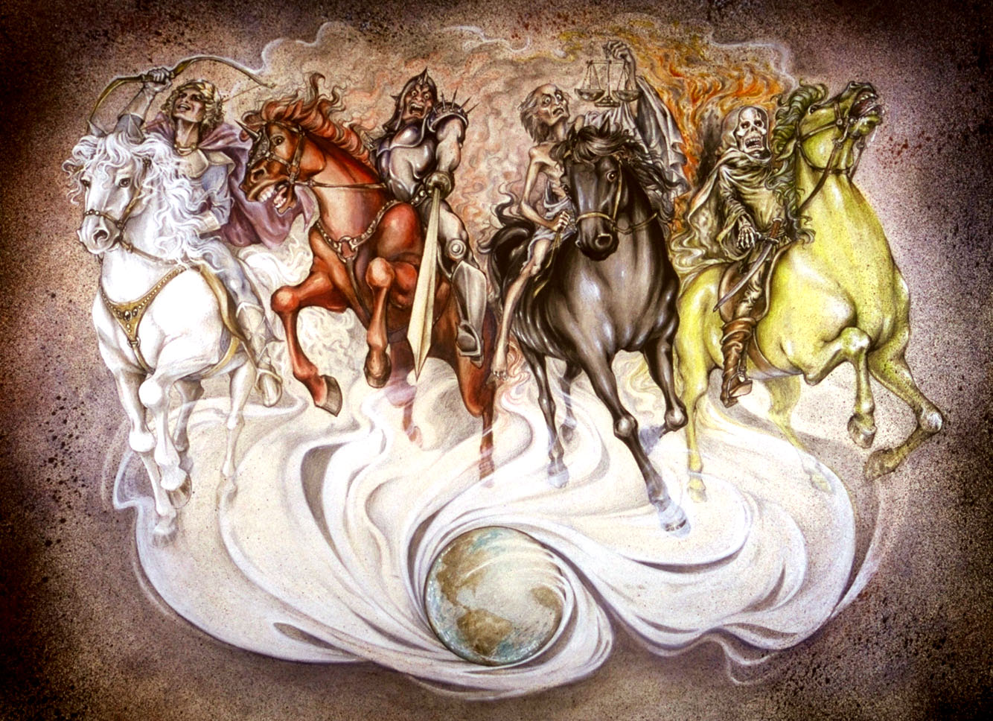
Tips For Understanding The Book of Revelation
Revelation 1:1-3

Slide 2
INTRODUCTION
How many of us here FULLY understand the book of Revelation?

Slide 3
INTRODUCTION
How many of us here FULLY understand the book of Revelation?
How many would like to BETTER understand it?

Slide 4
INTRODUCTION
How many of us here FULLY understand the book of Revelation?
How many would like to BETTER understand it?
In our studies/readings, we often
go to it, “poke at it”, leave it alone
That is the OPPOSITE of what God wants

Slide 5
INTRODUCTION
How many of us here FULLY understand the book of Revelation?
How many would like to BETTER understand it?
In our studies/readings, we often
go to it, “poke at it”, leave it alone
That is the OPPOSITE of what God wants
This sermon is based on one by Jeremy Jones

Slide 6
Briefly and Basically
Become familiar with symbolism in the rest of the Scriptures
The Lamb
Blood
Etc.

Slide 7
Briefly and Basically
Become familiar with symbolism in the rest of the Scriptures
The Lamb
Blood
Etc.
Learn your Old Testament (apocalyptic use)
Ezekiel, Isaiah, Daniel, etc.

Slide 8
Briefly and Basically
Become familiar with symbolism in the rest of the Scriptures
The Lamb
Blood
Etc.
Learn your Old Testament (apocalyptic use)
Ezekiel, Isaiah, Daniel, etc.
Learn your New Testament
New Testament Christianity
Doctrines and Promises

Slide 9
What is Apocalyptic Language?
From Greek: to uncover, disclose, reveal
Through church Latin: revelation, disclosure

Slide 10
What is Apocalyptic Language?
From Greek: to uncover, disclose, reveal
Through church Latin: revelation, disclosure
A style of writing that often
Describes the fates of nations (Matthew 24:29)
Nature is convulsing (Nahum 1:5-6)

Slide 11
What is Apocalyptic Language?
From Greek: to uncover, disclose, reveal
Through church Latin: revelation, disclosure
A style of writing that often
Describes the fates of nations (Matthew 24:29)
Nature is convulsing (Nahum 1:5-6)
Gives a message of hope to those who understand it…
While confusing and sounding like “so much nonsense” to those who don’t understand the symbolism

Slide 12
Why Does It Matter?
Out of 404 verses in the book of Revelation, approx. 280 contain quotes or allusions to the Old Testament. (About 68% - over 2/3 )

Slide 13
Why Does It Matter?
Out of 404 verses in the book of Revelation, approx. 280 contain quotes or allusions to the Old Testament. (About 68% - over 2/3 )
Most of them are from Deuteronomy, Isaiah, Ezekiel, Daniel, Joel, and Zechariah…books many Christians are not proficient in.

Slide 14
Why Does It Matter?
Out of 404 verses in the book of Revelation, approx. 280 contain quotes or allusions to the Old Testament. (About 68% - over 2/3 )
Most of them are from Deuteronomy, Isaiah, Ezekiel, Daniel, Joel, and Zechariah…books many Christians are not proficient in.
Symbols, visions, characters, locations, songs, and even plotlines are lifted directly from OT books.

Slide 15
Symbols
A sharp sword coming from Christ’s mouth.
(Compare Rev. 1:16 and Isaiah 49:2)
A lamb that was slain.
(Compare Rev. 5:6, Deut. 16, and Isaiah 53)

Slide 16
Symbols
A sharp sword coming from Christ’s mouth.
(Compare Rev. 1:16 and Isaiah 49:2)
A lamb that was slain.
(Compare Rev. 5:6, Deut. 16, and Isaiah 53)
A book that was sealed.
(Compare Rev. 5:1 with Daniel 12:4)
A book that was eaten.
(Compare Rev. 10:8-11 with Psalm 119:103, Jeremiah 15:16 and Ezekiel 2:8-3:3)

Slide 17
Visions
The vision of the 4 horsemen.
(Compare Rev. 6:1-8 with Zech. 1:7-17)
The vision of the 2 olive trees and 2 lamp stands.
(Compare Rev. 11:1-6 with Zech. 4:1-14)

Slide 18
Visions
The vision of the 4 horsemen.
(Compare Rev. 6:1-8 with Zech. 1:7-17)
The vision of the 2 olive trees and 2 lamp stands.
(Compare Rev. 11:1-6 with Zech. 4:1-14)
The harvest of the wicked with a sickle.
(Compare Rev. 14:14-16 with Joel 3:13-14 and Isaiah 63:1-6)
The vision of the great beast.
(Compare Rev. 13:1-6 with Daniel 7:1-8)

Slide 19
Characters
The Cherubim
Compare Rev. 4:6-8 w/Ezek. 1:5-14 & 10:20-22
Michael, the archangel
Compare Rev. 12:7-10 with Dan. 10:133

Slide 20
Characters
The Cherubim
Compare Rev. 4:6-8 w/Ezek. 1:5-14 & 10:20-22
Michael, the archangel
Compare Rev. 12:7-10 with Dan. 10:133
The one sitting on the throne
Compare Rev. 4 with Ex. 24:9-11 , Isa. 6, and Ezek. 1
The great dragon
Compare Rev. 12:1-10 with Gen. 3, Job 1-2, and Zech. 3

Slide 21
Locations
The throne surrounded by a glassy sea
Compare Rev. 4:1-6 with Ex. 24:9-11
The great bottomless pit (or abyss)
Compare Rev. 9:1-11 with Ezek. 32:17-32

Slide 22
Locations
The throne surrounded by a glassy sea
Compare Rev. 4:1-6 with Ex. 24:9-11
The great bottomless pit (or abyss)
Compare Rev. 9:1-11 with Ezek. 32:17-32
The heavenly temple
Compare Rev. 15 with Ezekiel 40-48

Slide 23
Locations
The throne surrounded by a glassy sea
Compare Rev. 4:1-6 with Ex. 24:9-11
The great bottomless pit (or abyss)
Compare Rev. 9:1-11 with Ezek. 32:17-32
The heavenly temple
Compare Rev. 15 with Ezekiel 40-48
The battlefield of Armageddon
Compare Rev. 16:13-16 with Zech. 12:11
The new heavens and new earth
Compare Rev. 21-22 with Isa. 65-66

Slide 24
Songs
The song of Moses is sung in heaven
Compare Revelation 15 with Exodus 15
The “Lament of Tyre” is adapted to become the “Lament of Babylon” in Revelation.
Compare Rev. 18:9-24 with Ezekiel 27:1-36 and the punishment of the nations found in Jeremiah 46-51

Slide 25
Plotlines
A great battle occurs; God protects His people (Rev. 19:11-21)
A resurrection happens. (Rev. 19:4)
A great battle occurs; God protects His people (Ezekiel 35-36)
A resurrection happens (Ezekiel 37:1-14)

Slide 26
Plotlines
A great battle occurs; God protects His people (Rev. 19:11-21)
A resurrection happens. (Rev. 19:4)
Christ rules (Rev. 19:5-6)
The battle of Gog and Magog. (Rev. 19:7-8)
A great battle occurs; God protects His people (Ezekiel 35-36)
A resurrection happens (Ezekiel 37:1-14)
Christ rules (Ez. 38:15-28)
The battle of Gog and Magog. (Ezekiel 38-39)

Slide 27
Plotlines
God’s people fully delivered. (Revelation 19:9-15)
God’s house is opened. (Revelation 21:1-21)
God Is there. (Revelation 21:22-22:21)
God’s people fully delivered. (Ezekiel 39:17-29)
God’s house is opened. (Ezekiel 40-43)
God Is there. (Ezekiel 43:1-5, 48:35)

Slide 28
Plotlines
There will be a new heavens and a new earth (Rev. 21:1)
God’s bride will be redeemed (Rev. 21:2, 9, 22:17)
There will be a new heavens and a new earth (Isa. 65:17-25)
God’s bride will be redeemed (Isaiah 54:4-8)

Slide 29
Plotlines
There will be a new heavens and a new earth (Rev. 21:1)
God’s bride will be redeemed (Rev. 21:2, 9, 22:17)
Mourning turned to joy (Rev. 21:4; 22:3)
The Lord will judge idolaters (Rev. 21:8, 27, 22:15)
There will be a new heavens and a new earth (Isa. 65:17-25)
God’s bride will be redeemed (Isaiah 54:4-8)
Mourning turned to joy (Isa. 54:1-3, 25:6-9)
The Lord will judge idolaters (Isaiah 66:14-17)

Slide 30
Plotlines
Drink water without cost (Rev. 21:6, 22:17)
A city made of precious stones will appear (Rev. 21:10-21)
God will be near them (Rev. 21:22-26, 22:3-5)
Drink water without cost (Isa. 55:1-2)
A city made of precious stones will appear (Isa. 54:11-12)
God will be near them (Isa. 55:3-11)

Slide 31
Other Tips
Let John interpret John – remember…
That there was an original audience – Rev. 1:4, 11; chapters 2-3
It was told in signs and symbols – Revelation 1:3, 9-20, 4:1-2

Slide 32
Other Tips
Let John interpret John – remember…
That there was an original audience – Rev. 1:4, 11; chapters 2-3
It was told in signs and symbols – Revelation 1:3, 9-20, 4:1-2
Let John’s other writings help interpret Rev.
Lamb of God (compare John 1:29 with Rev. 5:6)
Light of the world (compare John 8:12-20 with Rev. 21:22-24 and 22:5)
Water of life (compare John 4:1-26 and 7:37-39 with Rev. 21:6 and22:1)

Slide 33
Other Tips
Be prepared for paradoxes.
Poverty, which is actually wealth (Rev. 2:9) and wealth that is actually poverty (Rev. 3:17-19)
Christians have a name that they are alive, but they are dead. (Rev. 3:1)
The overcoming lion is a slain lamb. (Rev. 5:5-6)
The robes of the saints are washed white in blood. (Rev. 7:14)
The beast looks like a lamb, talks like a dragon. (Rev. 13:11)

Slide 34
Other Tips
Be prepared for paradoxes.
The people follow a lamb. (Rev. 14:4)
The white robes of the conqueror are stained with His own blood, not that of His enemies. (Rev. 19:11-14)
The Son’s sword is the Son’s word. (Rev. 1:16, 19:15)
The enemies are destroyed by words. (Rev. 19:19-21)

Slide 35
CONCLUSION
Understand the basics of the book first
Specific messages to the 7 Asian churches – 1:11
The final revelation of God’s plans – 5:1-7
Assurance and victory in Christ – 19:11-21
To give as many people as possible as many chances as possible to repent
Rev. 2:5, 16, 21-26, 3:2-3, 18, 6:8, 7:3, 8:11, 9:20-21, etc!
Only then can you start truly studying God’s word, not mans’ opinions

Slide 36
Are YOU a Christian?
Hear
Believe
Repent
Confess
Be Baptized
Continue Faithfully
Romans 10:17
Mark 16:16
Acts 2:38
Acts 22:16
Mark 16:16
Hebrews 10:38

