Slide 1
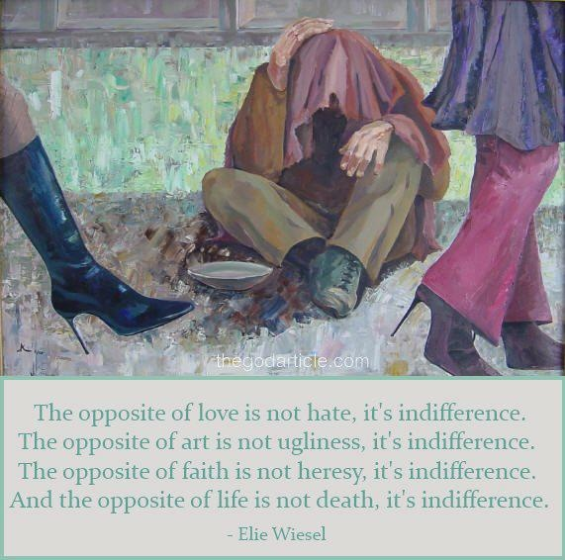
The Opposite of Love
Part 1
1 Corinthians 13

Slide 2
INTRODUCTION
“The opposite of love is not hate, but indifference.”
– Elie Wiesel

Slide 3
INTRODUCTION
“The opposite of love is not hate, but indifference.”
– Elie Wiesel
“Hate is not the opposite of love; apathy is.”
– Rollo May

Slide 4
INTRODUCTION
“The opposite of love is not hate, but indifference.”
– Elie Wiesel
“Hate is not the opposite of love; apathy is.”
– Rollo May
“The opposite of love is fear, not hate.”
– Yoko Ono

Slide 5
INTRODUCTION
“The opposite of love is not hate, but indifference.”
– Elie Wiesel
“Hate is not the opposite of love; apathy is.”
– Rollo May
“The opposite of love is fear, not hate.”
– Yoko Ono
“…the opposite of love is ignorance.”
– Brian Hwang

Slide 6
INTRODUCTION
There are different ways to learn
Often, we can learn about a word/idea by thinking about/studying its opposite
Good/evil
Heaven/hell
Loyalty/betrayal

Slide 7
INTRODUCTION
There are different ways to learn
Often, we can learn about a word/idea by thinking about/studying its opposite
Good/evil
Heaven/hell
Loyalty/betrayal
Today, let’s learn about love by studying its opposite(s)

Slide 8
INTRODUCTION
Often, when someone thinks about the opposite of love, they may think of hate

Slide 9
INTRODUCTION
Often, when someone thinks about the opposite of love, they may think of hate
But, love has many aspects (1 Corinthians 13)
A basis for our lives
A reason for our being
A goal to strive after

Slide 10
INTRODUCTION
Often, when someone thinks about the opposite of love, they may think of hate
But, love has many aspects (1 Corinthians 13)
A basis for our lives
A reason for our being
A goal to strive after
Using this chapter as an aid, let’s see what we can learn by considering its opposite

Slide 11
CONTEXT – 1 Cor. 13:1-3
Necessity – basis, reason, goal

Slide 12
CONTEXT – 1 Cor. 13:1-3
Necessity – basis, reason, goal
Speak…
Tongues of men/angels
(w/o love) become noisy gong/clanging cymbal

Slide 13
CONTEXT – 1 Cor. 13:1-3
Necessity – basis, reason, goal
Speak…
Tongues of men/angels
(w/o love) become noisy gong/clanging cymbal
Have…
Prophecy/mysteries/knowledge/faith
(w/o love) am nothing

Slide 14
CONTEXT – 1 Cor. 13:1-3
Necessity – basis, reason, goal
Speak…
Tongues of men/angels
(w/o love) become noisy gong/clanging cymbal
Have…
Prophecy/mysteries/knowledge/faith
(w/o love) am nothing
Give…
My possessions/my body
(w/o love) profits me nothing

Slide 15
Verse 4a
Love is patient; love is kind (basic pair)
Prov 17:9 (10:12); 1 Peter 4:8
Note: neither is uncontrolled
Patience is not forever (2 Peter 3:8-9)
Kindness is balanced with severity (Romans 11:22)

Slide 16
Verse 4a
Love is patient; love is kind (basic pair)
Prov 17:9 (10:12); 1 Peter 4:8
Note: neither is uncontrolled
Patience is not forever (2 Peter 3:8-9)
Kindness is balanced with severity (Romans 11:22)
…is not jealous (a “negative descriptor”)
Jealousy destroys; love edifies
Jealousy is impatient and unkind
Jealousy is me-centered; love is about the other
Jealousy is a counterfeit of love

Slide 17
Verse 4b
Love does not brag …and is not arrogant
The “ugly twins of jealousy” are similar/related

Slide 18
Verse 4b
Love does not brag …and is not arrogant
The “ugly twins of jealousy” are similar/related
Bragging tries to contaminate others w/jealousy (like a contagious disease)
It is an outward manifestation of inner pride
Matthew 6:2; Jeremiah 9:23-24; James 4:16

Slide 19
Verse 4b
Love does not brag …and is not arrogant
The “ugly twins of jealousy” are similar/related
Bragging tries to contaminate others w/jealousy (like a contagious disease)
It is an outward manifestation of inner pride
Matthew 6:2; Jeremiah 9:23-24; James 4:16
Arrogance is the wellspring of bragging
The “ ’I’ disease”
Arrogance is all about “me;” love is about others
Luke 12:15-21; 1 Corinthians 4:6-7; Proverbs 27:1-5
HODEL: “…the rabbi who must praise himself…”

Slide 20
Verse 5a
…does not act unbecomingly
Is not rude or willingly offensive/cause to blush
Lit. “ouk” (not ever) + ”Aschemoneo” (w/o form)

Slide 21
Verse 5a
…does not act unbecomingly
Is not rude or willingly offensive/cause to blush
Lit. “ouk” (not ever) + ”Aschemoneo” (w/o form)
No “situation ethics”-behave correctly regardless
Isaiah 3:5; Philippians 4:8; 2 Thessalonians 3:7

Slide 22
Verse 5a
…does not act unbecomingly
Is not rude or willingly offensive/cause to blush
Lit. “ouk” (not ever) + ”Aschemoneo” (w/o form)
No “situation ethics”-behave correctly regardless
Isaiah 3:5; Philippians 4:8; 2 Thessalonians 3:7
It does not seek its own
We put others first – Jesus (Matt 20:28; Phil 2)
Is not self-centered (cause of many arguments)

Slide 23
Verse 5a
…does not act unbecomingly
Is not rude or willingly offensive/cause to blush
Lit. “ouk” (not ever) + ”Aschemoneo” (w/o form)
No “situation ethics”-behave correctly regardless
Isaiah 3:5; Philippians 4:8; 2 Thessalonians 3:7
It does not seek its own
We put others first – Jesus (Matt 20:28; Phil 2)
Is not self-centered (cause of many arguments)
Little boy who “laid down his life” for his sister
Twist facts, loopholes, twist arms, manipulate

Slide 24
Verse 5b
Is not provoked (to anger)
KJV: “easily” not in Gr-King James’ violent temper

Slide 25
Verse 5b
Is not provoked (to anger)
KJV: “easily” not in Gr-King James’ violent temper
James 1:19 – “quick…slow…slow…”
Matt 5:22 – outburst/fit/convulsion

Slide 26
Verse 5b
Is not provoked (to anger)
KJV: “easily” not in Gr-King James’ violent temper
James 1:19 – “quick…slow…slow…”
Matt 5:22 – outburst/fit/convulsion
Mark 3:5 (God still does good) godly/righteous

Slide 27
Verse 5b
Is not provoked (to anger)
KJV: “easily” not in Gr-King James’ violent temper
James 1:19 – “quick…slow…slow…”
Matt 5:22 – outburst/fit/convulsion
Mark 3:5 (God still does good) godly/righteous
Does not take into account a wrong suffered
Keeps no record of wrongs/forgiving-parent/child
“Father, forgive them…” – Luke 23:34

Slide 28
Verse 5b
Is not provoked (to anger)
KJV: “easily” not in Gr-King James’ violent temper
James 1:19 – “quick…slow…slow…”
Matt 5:22 – outburst/fit/convulsion
Mark 3:5 (God still does good) godly/righteous
Does not take into account a wrong suffered
Keeps no record of wrongs/forgiving-parent/child
“Father, forgive them…” – Luke 23:34
God forgives us and no longer counts us as guilty
“Debt” – Matt 6:12; 18:21-35

Slide 29
CONCLUSION
Because (agape) love is multi-faceted, it has many opposites.
The aspects of love are distinctive and
They overlap to form a whole
The opposites, therefore, are also many
And, they help us understand this basic, multi-faceted aspect of God as we strive to imitate Him
God is love; …for God so loved the world

Slide 30
Are YOU a Christian?
Hear
Believe
Repent
Confess
Be Baptized
Continue Faithfully
Romans 10:17
Mark 16:16
Acts 2:38
Acts 22:16
Mark 16:16
Hebrews 10:38

