Slide 1
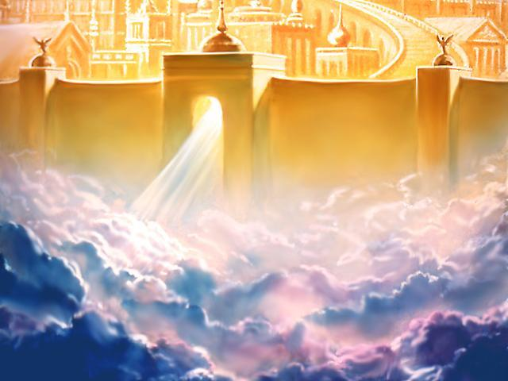
There Is A God in Heaven
Daniel 2:25-28

Slide 2
INTRODUCTION
Nebuchadnezzar has a dream
He orders that the he be told the dream and its meaning
None of the magicians, diviners, etc. can do it
He orders that, unless someone does it, all will die

Slide 3
INTRODUCTION
Nebuchadnezzar has a dream
He orders that the he be told the dream and its meaning
None of the magicians, diviners, etc. can do it
He orders that, unless someone does, all will die
Daniel is told of this
He prays with his friends
He tells the king his dream & the interpretation
The king is impressed, the people saved
God gets the glory

Slide 4
The Lesson For Us
There is still “a God in Heaven” for us to go to during our needs

Slide 5
The Lesson For Us
There is still “a God in Heaven” for us to go to during our needs
Let’s look at some examples in the Bible
The Israelites at the Red Sea
Gideon
Shadrach, Meshach & Abed-Nego
Peter
Paul

Slide 6
The Israelites at the Red Sea
Exodus 14:10-11 – At the Red Sea, the Israelites were scared (and complaining)
Pharaoh had let them go, but had now sent his army after them
They had the Red Sea on one side and the army of Pharaoh on the other

Slide 7
The Israelites at the Red Sea
Exodus 14:10-11 – At the Red Sea, the Israelites were scared (and complaining)
Pharaoh had let them go, but had now sent his army after them
They had the Red Sea on one side and the army of Pharaoh on the other
vv 13-16 – God will fight for you (while you keep silent)

Slide 8
Gideon
Judges 6 – Times of the Judges
The Midianites had oppressed them for 7 years
The Angel of the Lord appears to Gideon
He encourages Gideon
Gideon leads 300 men against the Midianites

Slide 9
Gideon
Judges 6 – Times of the Judges
The Midianites had oppressed them for 7 years
The Angel of the Lord appears to Gideon
He encourages Gideon
Gideon leads 300 men against the Midianites
There is a God in heaven who defends those who repent and cry out to Him

Slide 10
Shadrach, Meshach & Abed-Nego
Daniel 3 – They demonstrate this lesson for us
Nebuchadnezzar has forgotten his statement about God made to Daniel in the previous chapter
Shadrach, Meshach & Abed-Nego will not bow down before the idol created by Nebuchadnezzar
There is a law
Given “one last chance”
vv 17-18 – God will deliver, but even if not…

Slide 11
Shadrach, Meshach & Abed-Nego
Daniel 3 – They demonstrate this lesson for us
Nebuchadnezzar has forgotten his statement about God made to Daniel in the previous chapter
Shadrach, Meshach & Abed-Nego will not bow down before the idol created by Nebuchadnezzar
There is a law
Given “one last chance”
vv 17-18 – God will deliver, but even if not…
vv 24-27 – The God of heaven does deliver them

Slide 12
Peter
Matthew 16:15-19 – Peter had made the good confession
Matthew 26:34 – However, Peter was going to deny Jesus

Slide 13
Peter
Matthew 16:15-19 – Peter had made the good confession
Matthew 26:34 – However, Peter was going to deny Jesus
Acts 2 – Peter had repented and turned back to God, he was a leader among Christians
Acts 12:3-9 – In jail, Peter is reminded that there is a God in heaven

Slide 14
Peter
Matthew 16:15-19 – Peter had made the good confession
Matthew 26:34 – However, Peter was going to deny Jesus
Acts 2 – Peter had repented and turned back to God, he was a leader among Christians
Acts 12:3-9 – In jail, Peter is reminded that there is a God in heaven
Galatians 2:11-14 – He still was not perfect

Slide 15
Paul
Paul was a Pharisee, violently opposed to Christianity
He persecuted the early church
He calls himself “the foremost of sinners”

Slide 16
Paul
Paul was a Pharisee, violently opposed to Christianity
He persecuted the early church
He calls himself “the foremost of sinners”
On the road to Damascus, Paul is reminded there is a God in heaven who cares
He suffered much for the cause of Christ
He worked hard, he trusted God (faith that works)
He finished the course

Slide 17
The Lesson for Us
Have you ever been in great distress?
Financial – caused by you or others
Physical – sickness, aged, accident, bad habits

Slide 18
The Lesson for Us
Have you ever been in great distress?
Financial – caused by you or others
Physical – sickness, aged, accident, bad habits
Between “a rock and a hard place”
Any way you take is bad
Don’t look around; look up

Slide 19
The Lesson for Us
Have you ever been in great distress?
Financial – caused by you or others
Physical – sickness, aged, accident, bad habits
Between “a rock and a hard place”
Any way you take is bad
Don’t look around; look up
2 Peter 2:4-10a – If…, if…, if…then…
1 Corinthians 1:9 – God is faithful…

Slide 20
The Lesson for Us
There may come a time when you are required to take a stand for God
Friends/family
Government
Popular opinion
Culture
It may mean persecution

Slide 21
The Lesson for Us
There may come a time when you are required to take a stand for God
Friends/family
Government
Popular opinion
Culture
It may mean persecution
Remember, there is a God in heaven

Slide 22
The Lesson for Us
When you sin
Previous to becoming a Christian
After you have named Christ
John 2:24-25 – God knows before you tell Him
1 John 1:9 – God will forgive us our sins, if we confess them

Slide 23
The Lesson for Us
When you sin
Previous to becoming a Christian
After you have named Christ
John 2:24-25 – God knows before you tell Him
1 John 1:9 – God will forgive us our sins, if we confess them
There is a God in heaven Who knows and cares

Slide 24
The Lesson for Us
When you are near death
Sin & death were Satan’s 2 big weapons against us
Jesus overcame sin through His death
Then, He overcame death through His resurrection

Slide 25
The Lesson for Us
When you are near death
Sin & death were Satan’s 2 big weapons against us
Jesus overcame sin through His death
Then, He overcame death through His resurrection
We cannot avoid death (Hebrews 9:27)
But, we don’t have to fear it (1 Cor. 15:53-58)
Because, there is a God in heaven Who loves us

Slide 26
CONCLUSION
So many other examples
Ruth, Esther,
Jonathan, Elijah

Slide 27
CONCLUSION
So many other examples
Ruth, Esther,
Jonathan, Elijah
We need to always remember God, Who is in heaven
In our sickness
In our troubles and weaknesses
When we have sinned
In all things

Slide 28
Are YOU a Christian?
Hear
Believe
Repent
Confess
Be Baptized
Continue Faithfully
Romans 10:17
Mark 16:16
Acts 2:38
Acts 22:16
Mark 16:16
Hebrews 10:38

