Slide 1
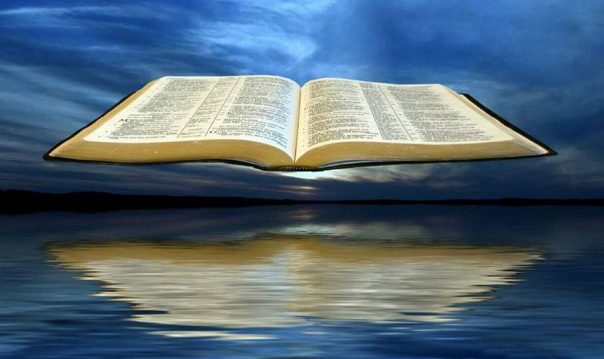
Back-to-Basics – God’s Written Word
Proverbs 30:5-6

Slide 2
INTRODUCTION
We are often heard to speak
Of “Book, Chapter, Verse”
Of “God’s complete revelation”
Of “Sola Scriptura”
Of “the abiding word of God”

Slide 3
INTRODUCTION
We are often heard to speak
Of “Book, Chapter, Verse”
Of “God’s complete revelation”
Of “Sola Scriptura”
Of “the abiding word of God”
But, we may not be fully aware
Of the full meaning of what these phrases mean
Of the implications of these truths

Slide 4
INTRODUCTION
We are often heard to speak
Of “Book, Chapter, Verse”
Of “God’s complete revelation”
Of “Sola Scriptura”
Of “the abiding word of God”
But, we may not be fully aware
Of the full meaning of what these phrases mean
Of the implications of these truths
Let’s see what God’s word says about itself

Slide 5
It is written
Exodus 24:3-4
Moses read the words (the people agreed)
He wrote down the words

Slide 6
It is written
Exodus 24:3-4
Moses read the words (the people agreed)
He wrote down the words
Deuteronomy 31:9-13; 24-26
Read (remind, learn) every seven years
At the end of Moses’ life…finished writing…
To Levites: “…beside the Ark of the Covenant…”
As a witness against you

Slide 7
It is written
Joshua 24:24-27
People agreed; covenant made
Words written; stone set up as a witness

Slide 8
It is written
Joshua 24:24-27
People agreed; covenant made
Words written; stone set up as a witness
1 Samuel 10:25
Wrote them down
Placed the book before the Lord

Slide 9
It is written
Joshua 24:24-27
People agreed; covenant made
Words written; stone set up as a witness
1 Samuel 10:25
Wrote them down
Placed the book before the Lord
Isaiah 30:8
“Now, go, write/inscribe…”
As a witness

Slide 10
It is written
Ezra 7:10 – Set his heart to…
Study the Law
Practice it
Teach it

Slide 11
It is written
Ezra 7:10 – Set his heart to…
Study the Law, practice it, teach it
“It is written”
Old Testament – 27x
New Testament writers – 72x (NASB)

Slide 12
It is written
Ezra 7:10 – Set his heart to…
Study the Law, practice it, teach it
“It is written”
Old Testament – 27x
New Testament writers – 72x (NASB)
Recognized the authority of the written word
Romans 3:2 – Jews entrusted w/oracles of God

Slide 13
It is written
Ezra 7:10 – Set his heart to…
Study the Law, practice it, teach it
“It is written”
Old Testament – 27x
New Testament writers – 72x (NASB)
Recognized the authority of the written word
Romans 3:2 – Jews entrusted w/oracles of God
“It is written” by NT writers refers to OT writings

Slide 14
Jesus
Matthew 22:23-29
The Sadducees were not sincere

Slide 15
Jesus
Matthew 22:23-29
The Sadducees were not sincere
Like the devil (Matt 4:1-10), they were trying to use God’s word against God
Like the devil, they were going to receive a rebuke

Slide 16
Jesus
Matthew 22:23-29
The Sadducees were not sincere
Like the devil (Matt 4:1-10), they were trying to use God’s word against God
Like the devil, they were going to receive a rebuke
“You are mistaken” (They are believing a lie)
“…not understanding the Scriptures…”
“…nor the power of God.”

Slide 17
Jesus
Matthew 22:29
The Sadducees were not sincere
Like the devil (Matt 4:1-10), they were trying to use God’s word against God
Like the devil, they were going to receive a rebuke
“You are mistaken” (They are believing a lie)
“…not understanding the Scriptures…”
“…nor the power of God.”
Compare to John 3:10 - Nicodemus

Slide 18
Jesus
John 14:26 (cf 8:31-32)
Jesus taught many things to the Apostles
And, they witnessed many things
But, there was even more that would be needed
And, human memory isn’t perfect

Slide 19
Jesus
John 14:26 (cf 8:31-32)
Jesus taught many things to the Apostles
And, they witnessed many things
But, there was even more that would be needed
And, human memory isn’t perfect
Therefore, the Holy Spirit would:
Teach
Bring to remembrance

Slide 20
Jesus
John 14:26 (cf 8:31-32)
Jesus taught many things to the Apostles
And, they witnessed many things
But, there was even more that would be needed
And, human memory isn’t perfect
Therefore, the Holy Spirit would:
Teach
Bring to remembrance
2 Tim 3:14ff-Many today: incompl, outdated, err
All the spiritual truth we need is in the Scriptures

Slide 21
Psalm 119
Verse 89 – Forever settled (stands firm) in Heaven
This is why it can’t be destroyed! The originals are in Heaven

Slide 22
Psalm 119
Verse 89 – Forever settled (stands firm) in Heaven
This is why it can’t be destroyed! The originals are in Heaven
Notice Exodus 34:1-2 – new tablets; same Law

Slide 23
Psalm 119
Verse 89 – Forever settled (stands firm) in Heaven
This is why it can’t be destroyed! The originals are in Heaven
Notice Exodus 34:1-2 – new tablets; same Law
Also Jeremiah 36:1-2, 23, 32
God’s words are written for the nation’s benefit
Jehoiakim doesn’t like it and cuts/burns the scroll
God’s original words are re-written, plus more added

Slide 24
Psalm 119
Verse 89 – Forever settled (stands firm) in Heaven
This is why it can’t be destroyed! The originals are in Heaven
Notice Exodus 34:1-2 – new tablets; same Law
Also Jeremiah 36:1-2, 23, 32
God’s words are written for the nation’s benefit
Jehoiakim doesn’t like it and cuts/burns the scroll
God’s original words are re-written, plus more added
We put more emphasis than God on “the originals”

Slide 25
Psalm 119
Verses 105-106
Statement of fact: Lamp, light
Consequence: I will keep your righteous ordinances

Slide 26
Psalm 119
Verses 105-106
Statement of fact: Lamp, light
Consequence: I will keep your righteous ordinances
Verse 160
The sum of Your words is truth
Every one…everlasting

Slide 27
Some Things the Word Does
1 Peter 1:23-25 – Birth

Slide 28
Some Things the Word Does
1 Peter 1:23-25 – Birth
John 6:63 – spirit, life
John 17:17 - Sanctification

Slide 29
Some Things the Word Does
1 Peter 1:23-25 – Birth
John 6:63 – spirit, life
John 17:17 - Sanctification
Romans 1:16 – power, saves
Ephesians 5:26 – cleanse, wash
Colossians 3:16 – Indwells (dwells in)

Slide 30
Some Things the Word Does
1 Peter 1:23-25 – Birth
John 6:63 – spirit, life
John 17:17 - Sanctification
Romans 1:16 – power, saves
Ephesians 5:26 – cleanse, wash
Colossians 3:16 – Indwells (dwells in)
Ephesians 6:17 – sword (only attack weapon)

Slide 31
CONCLUSION
God’s inspired word…all we need to know
To become Christians (born)
To live godly lives on earth
To get to Heaven

Slide 32
CONCLUSION
God’s inspired word…all we need to know
To become Christians (born) – begin the journey
To live godly lives on earth – be faithful to the journey
To get to Heaven – finish the journey

Slide 33
CONCLUSION
God’s inspired word…all we need to know
To become Christians (born) – begin the journey
To live godly lives on earth – be faithful to the journey
To get to Heaven – finish the journey
It is complete
Cannot add to, take from, change in any way
Any attempt is punishable by God
Let’s respect it and stand in it

Slide 34
Are YOU a Christian?
Hear
Believe
Repent
Confess
Be Baptized
Continue Faithfully
Romans 10:17
Mark 16:16
Acts 2:38
Acts 22:16
Mark 16:16
Hebrews 10:38

